Slide 1
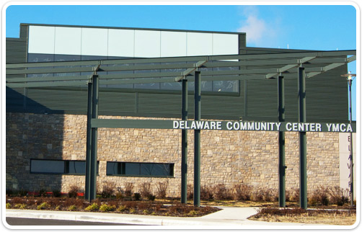
Delaware Community Center YMCA Coaches Meeting

Slide 2
YMCA Mission & Values
Live the YMCA’s Four Values:
Honesty: Show a sincere concern for others
Caring: Be truthful in what you say and do
Respect: Follow the golden rule
Responsibility: Be accountable for your promise and actions

Slide 3
Coaching Youth Sports
Responsibilities:
Assistant Coach: Choose a responsible individual to help with games and practices.
Communication: Coaches should maintain appropriate communication with players’ parents and the league coordinator throughout the season.
Equipment: All equipment should be in good condition and in working order. Contact league coordinator immediately to replace broken equipment.
Practice and Games: Coaches are responsible for scheduling and communicating practice and game times.

Slide 4
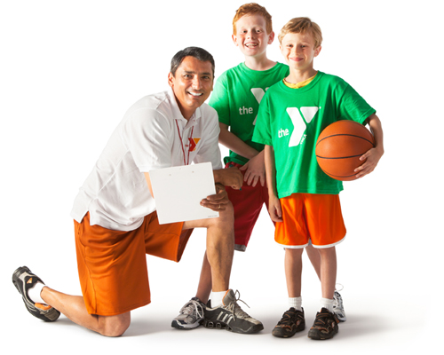
Coaching Youth Sports
Level of Commitment:
3-5 Hours/week (planning, practice, & games)
Volunteer Characteristics & Qualifications:
Possess core values and model positive behavior
Be able to teach and/or learn to teach age appropriate skills of the game
Knowledge of sport coaching
Completion of e-learning online training

Slide 5
YMCA Seven Pillars of Youth Sports
Everyone Plays -everyone who registers is assigned to a team. During the season everyone receives equal practice and play time.
Safety First -be sure that all equipment and facilities are in safe and working order. Teach all skills at the appropriate age and developmental level to prevent injuries.
Fair Play -demonstrating respect for all who are involved in YMCA sports and playing by the rules. Be a good role model for good sportsmanship and guiding your players to do the same.
Positive Competition -competition is a positive process when the pursuit of victory is kept in the right perspective.
Family Involvement -the YMCA encourages parents to be appropriately involved with their child’s sports participation. Additional ways to be involved include volunteer coaching & officiating.
Sport for All –YMCA Youth Sports is an inclusive sport program. We offer programs to all children regardless of their race, gender, religion, or ability.
Sport for Fun –remember that these sports are for the kids, let them have fun!

Slide 6
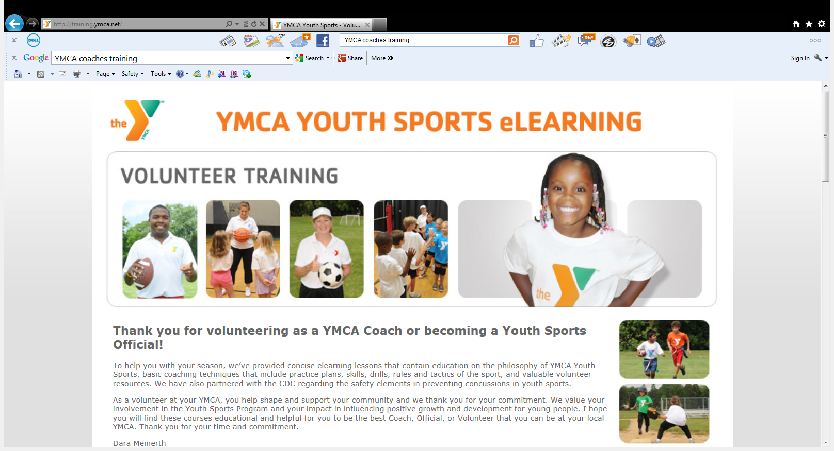
Sports eLearning Courses
http://training.ymca.net/

Slide 7
How to Access eLearning
Thank you for volunteering as a YMCA Coach or becoming a Youth Sports Official! To help you with your season, we have developed and provided e-learning lessons for you to complete prior to your second scheduled practice.
Steps to enroll in the e-learning courses:
1. Type or copy and paste the web address below into your Internet Browser http://training.ymca.net
2. Click on the first Core Course titled “YMCA Youth Sports Program”
3. Follow the instructions on the course page
4. Take and complete all other Core Courses listed on page 7 followed by the specific sport that you are coaching or officiating this season.
5. If you have difficulty accessing any of the courses, please contact your YMCA supervisor.

Slide 8
Delaware YMCA Coaches Online Training Courses
YMCA Youth Sports Program 15min
Coaching YMCA Youth Sports 30min
Sport Specific Course 45min
Total Time 1:15min
*These are the essential courses for all volunteer coaches, there are additional courses available online.

Slide 9
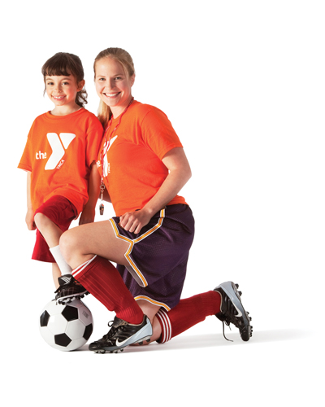
The “IDEA”
I=Introduce the skill
D=Demonstrate the skill
E=Explain the skill
A=Attend to players practicing

Slide 10
Game Day Tips
Arrive 20-30 minutes early to warm-up team.
Have a tentative game plan and line-up prepared.
Status with Refs and opposing team’s coach
Pre-game talk to encourage team
Execute plan, mix-up players so everyone gets a chance to play
HAVE FUN!

